Slide 1
Hvor er videnskaben nået til?
Marcus Nørgaard Weng

Slide 2
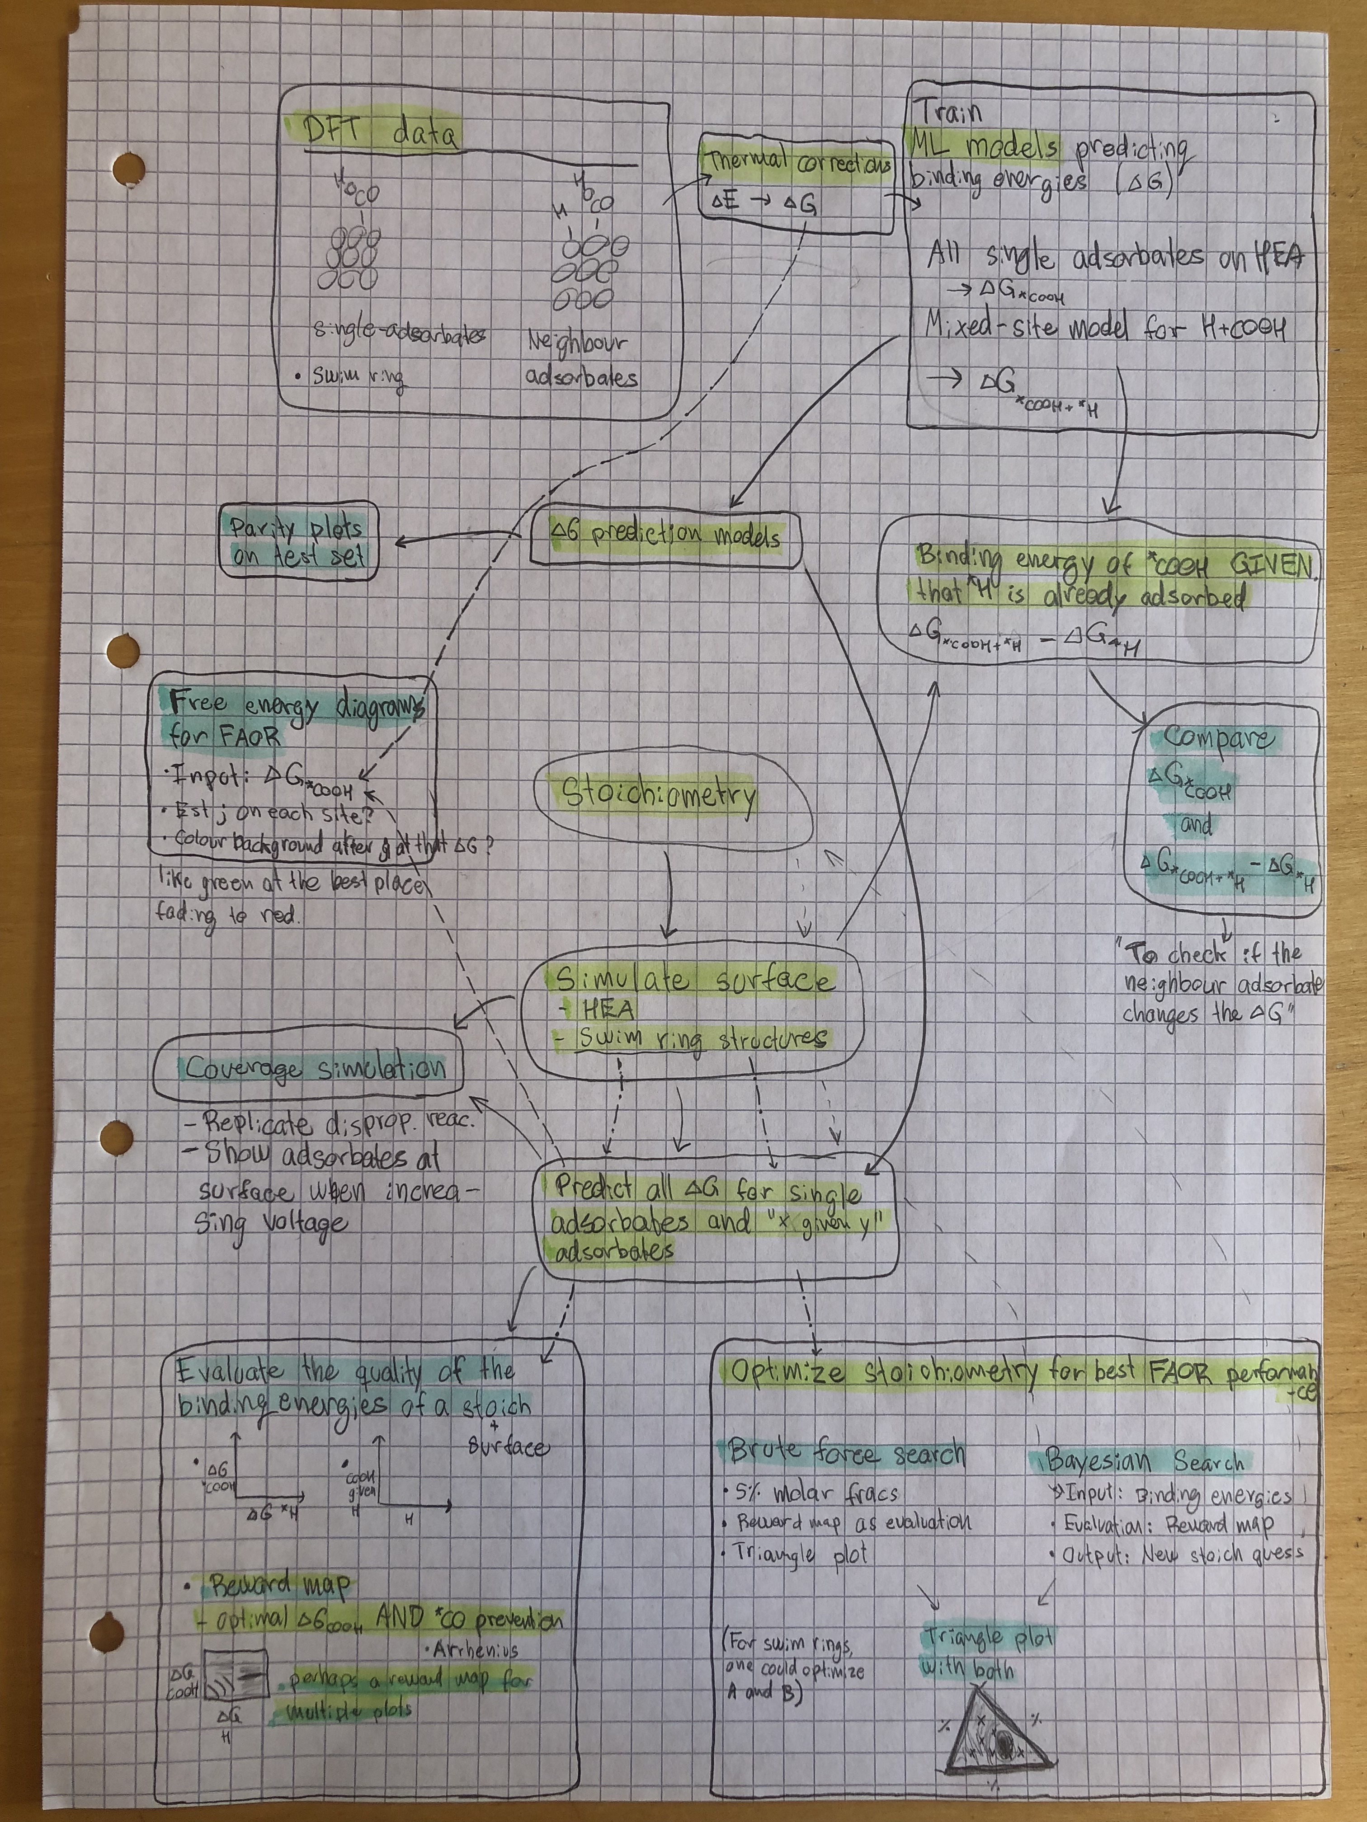

Slide 7
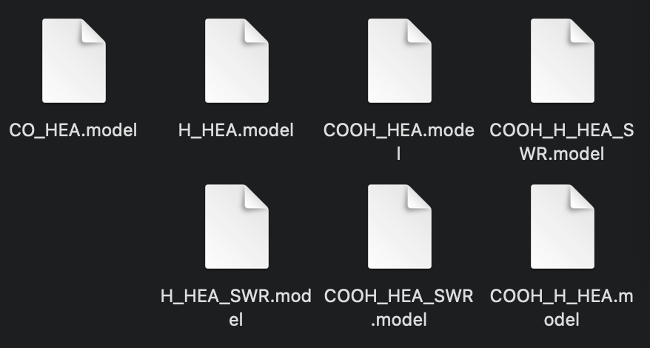

$$C_{correction}=ZPE+∫C_{p}dT−TS$$
$$G=E+C_{correction}$$

Slide 8
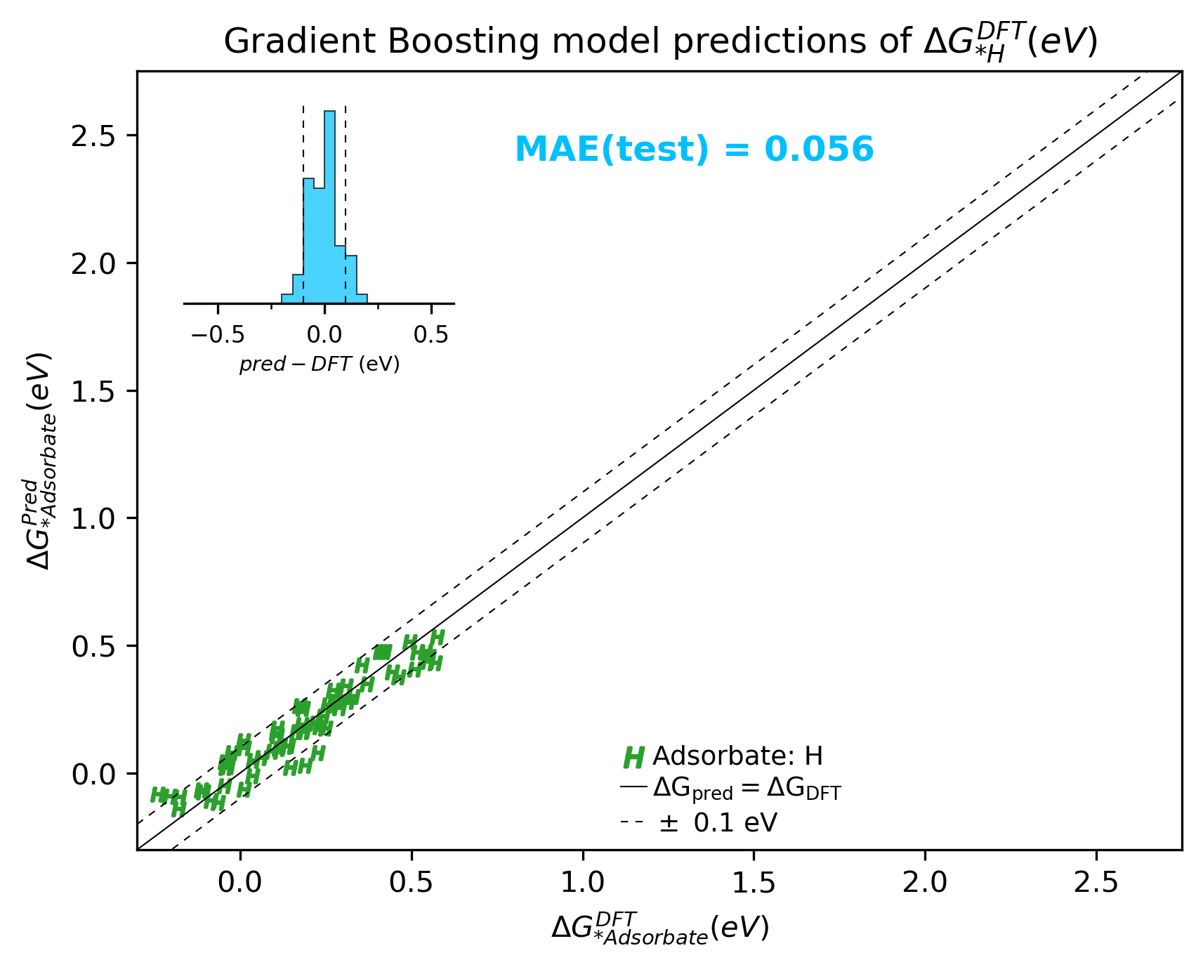
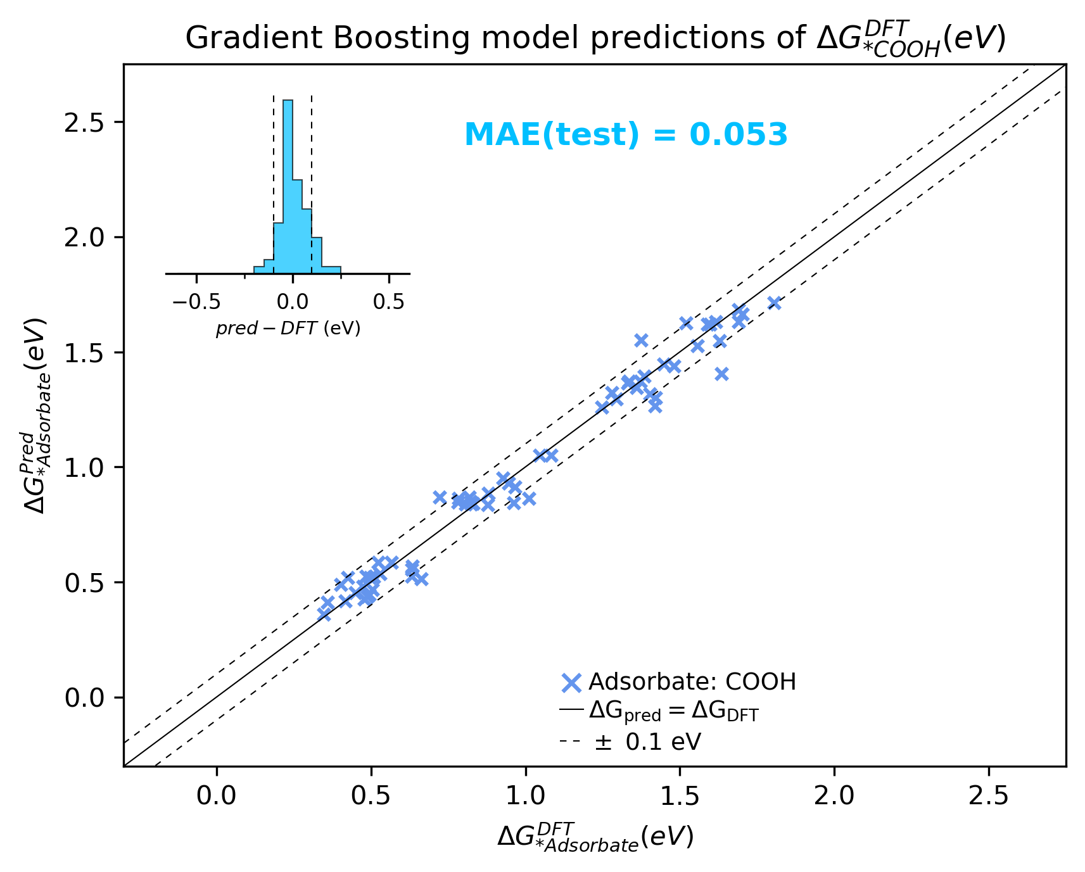
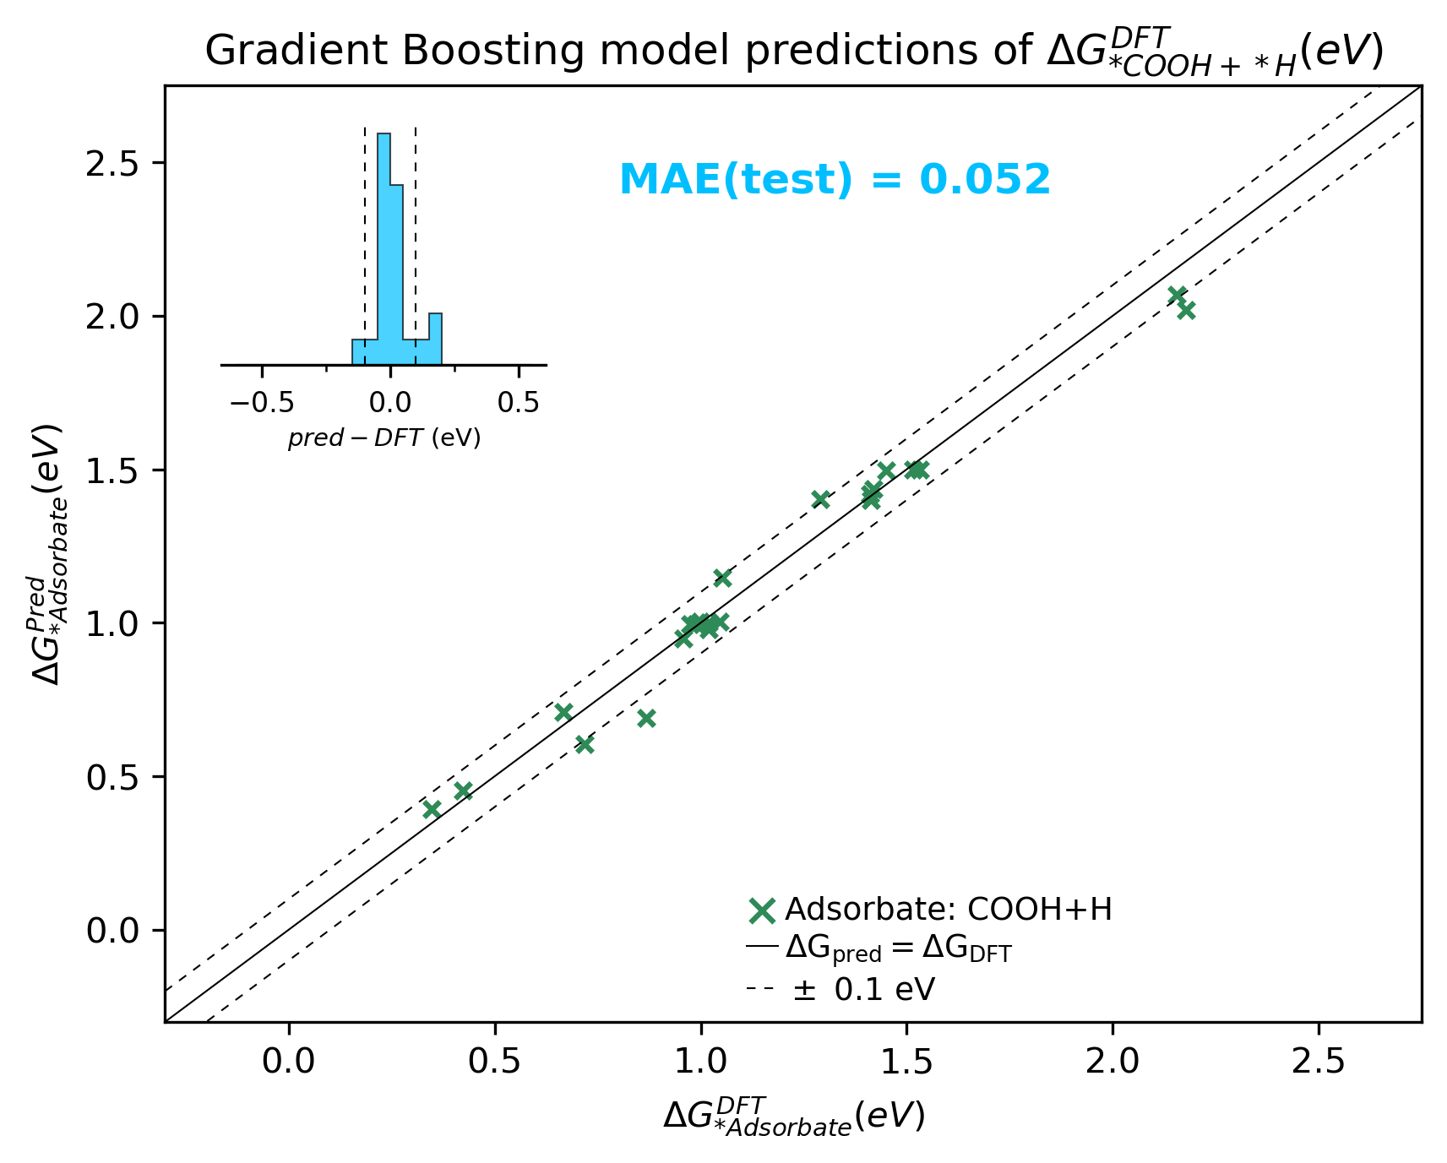
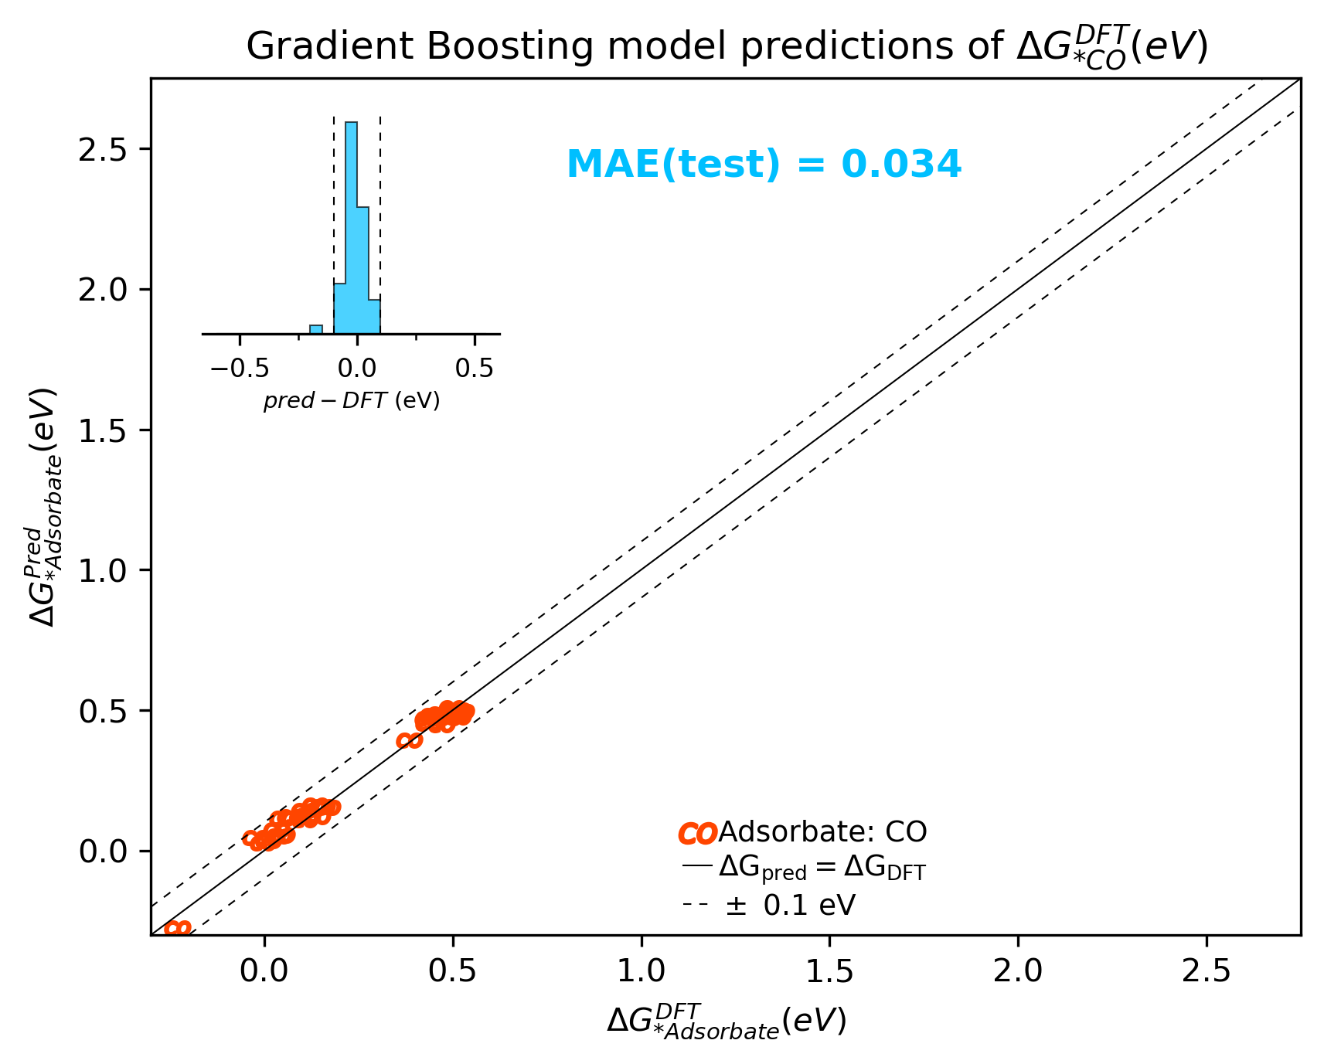
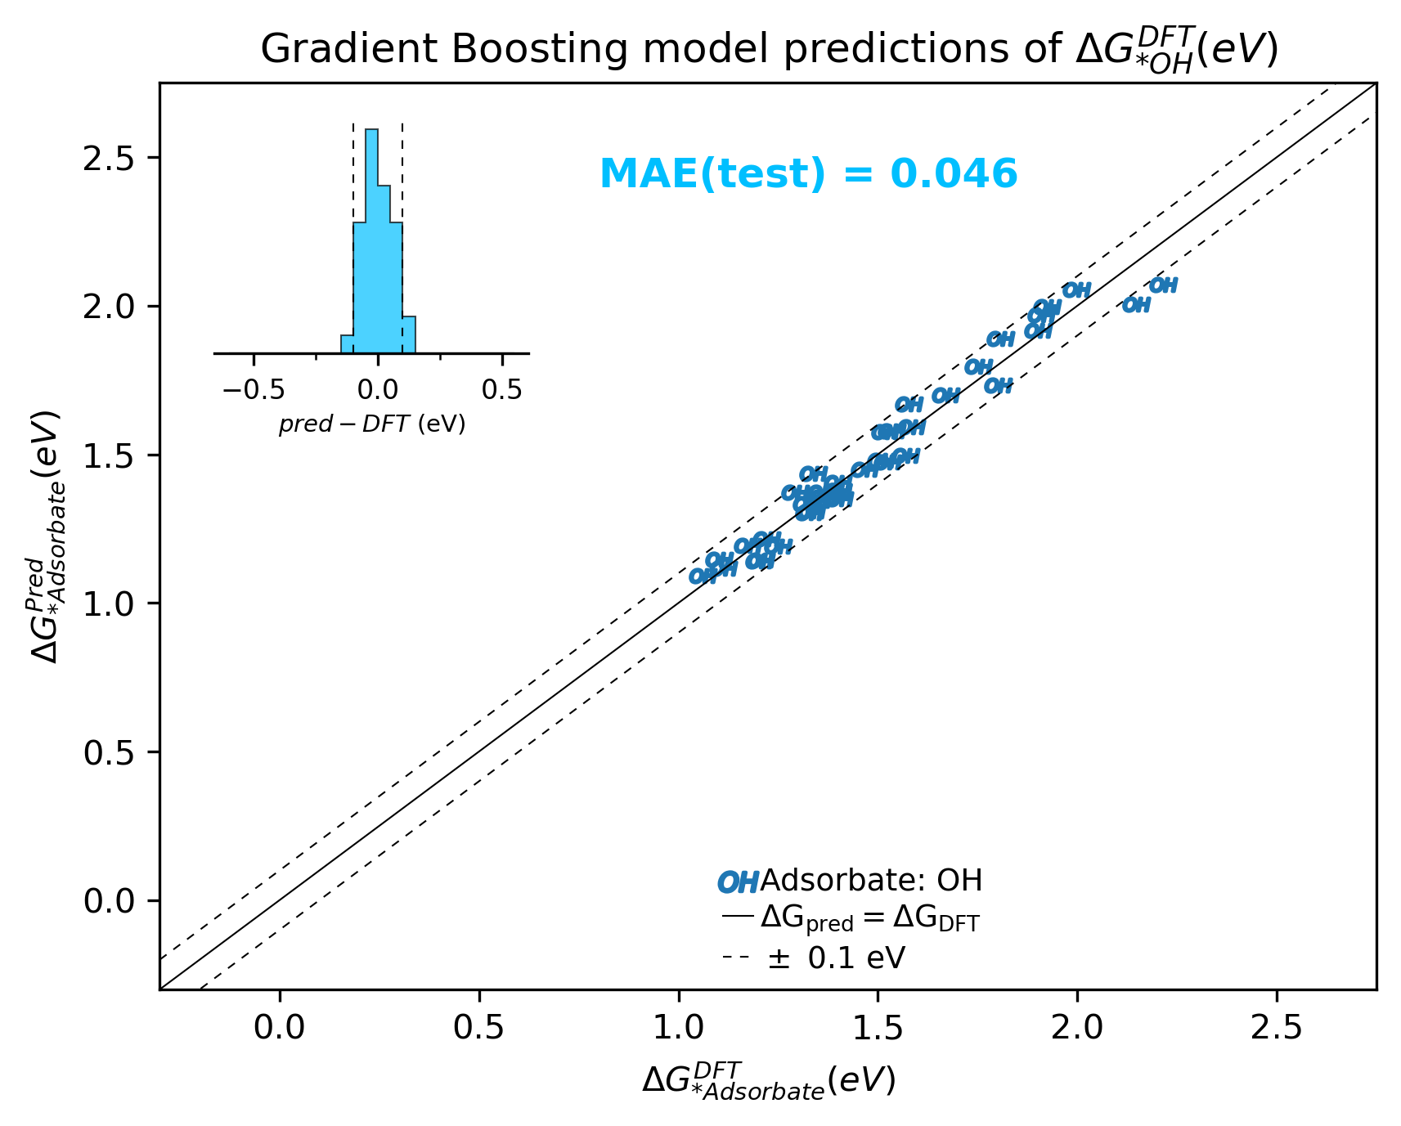
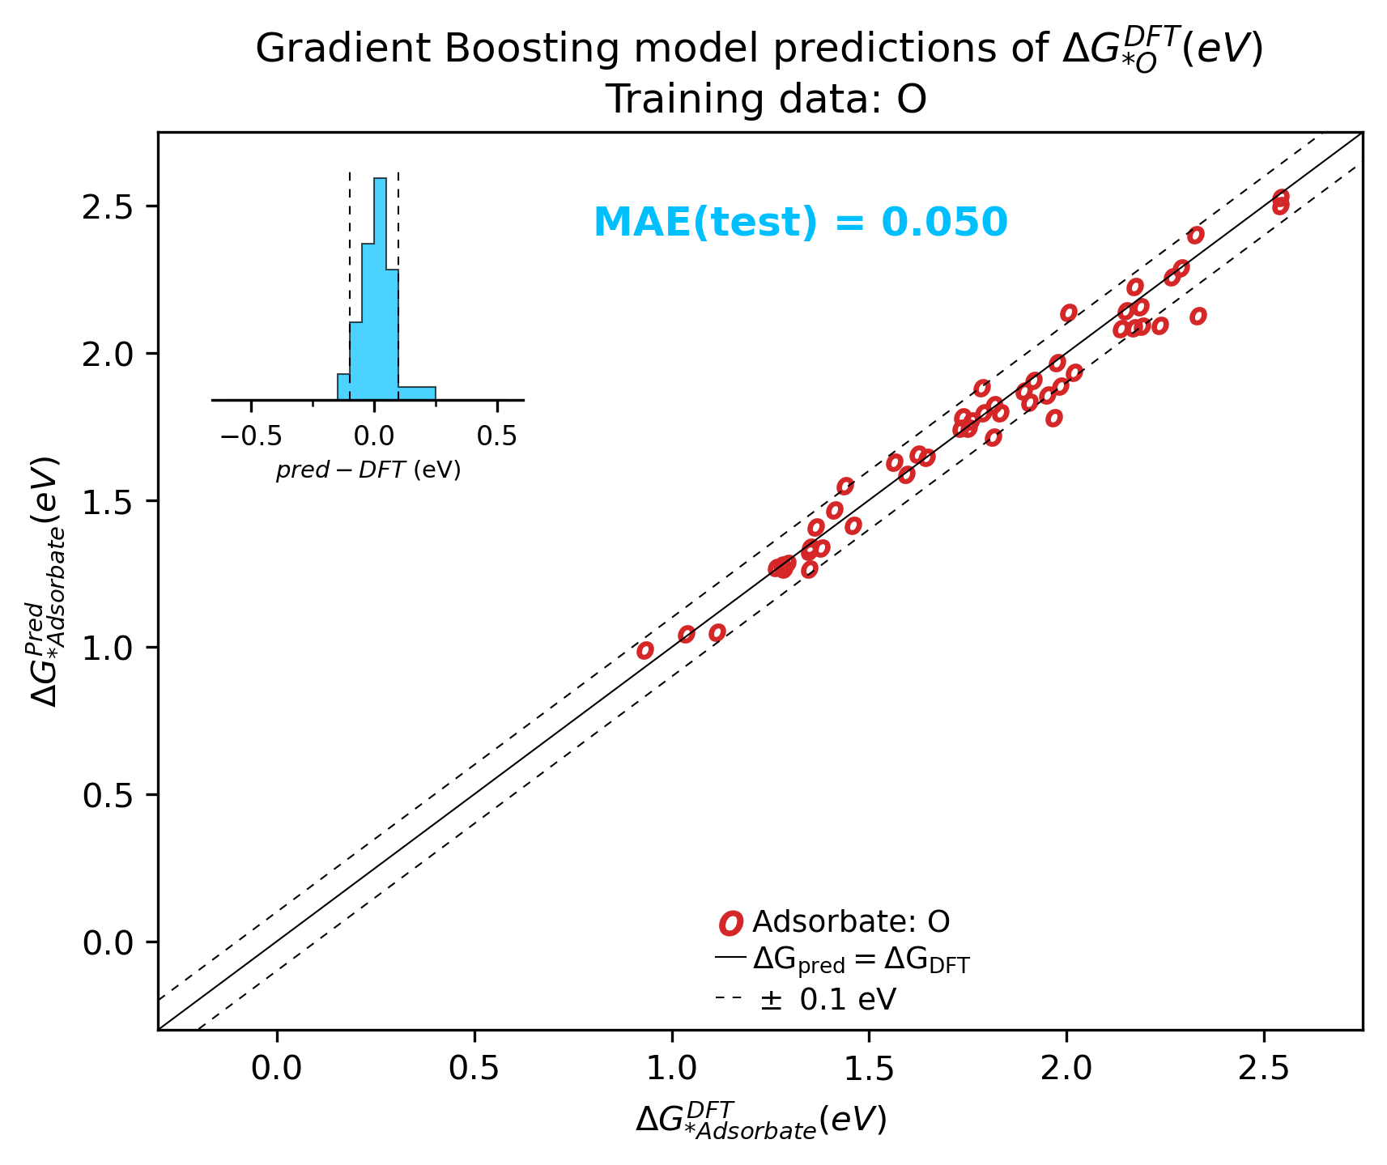

Slide 9
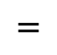
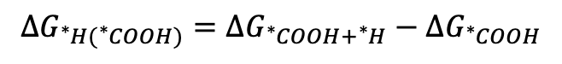
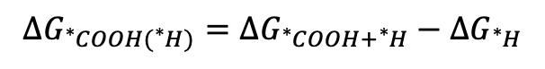
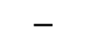
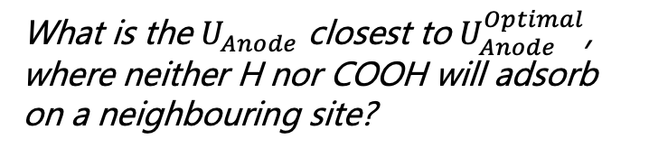
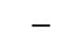
Binding energies of COOH and H given the presence of the other one
$$ΔG_{{}_{ }^{∗}{COOH({}_{ }^{∗}H)}}=ΔG_{{}_{ }^{∗}{COOH}+{}_{ }^{∗}H}−ΔG_{{}_{ }^{∗}H}$$
$$=$$
$$−$$
What is the $U_{Anode}$ closest to $U_{Anode}^{Optimal}$, where neither H nor COOH will adsorb on a neighbouring site?
$$ΔG_{{}_{ }^{∗}{H({}_{ }^{∗}{COOH})}}=ΔG_{{}_{ }^{∗}{COOH}+{}_{ }^{∗}H}−ΔG_{{}_{ }^{∗}{COOH}}$$
$$=$$
$$−$$

Slide 10
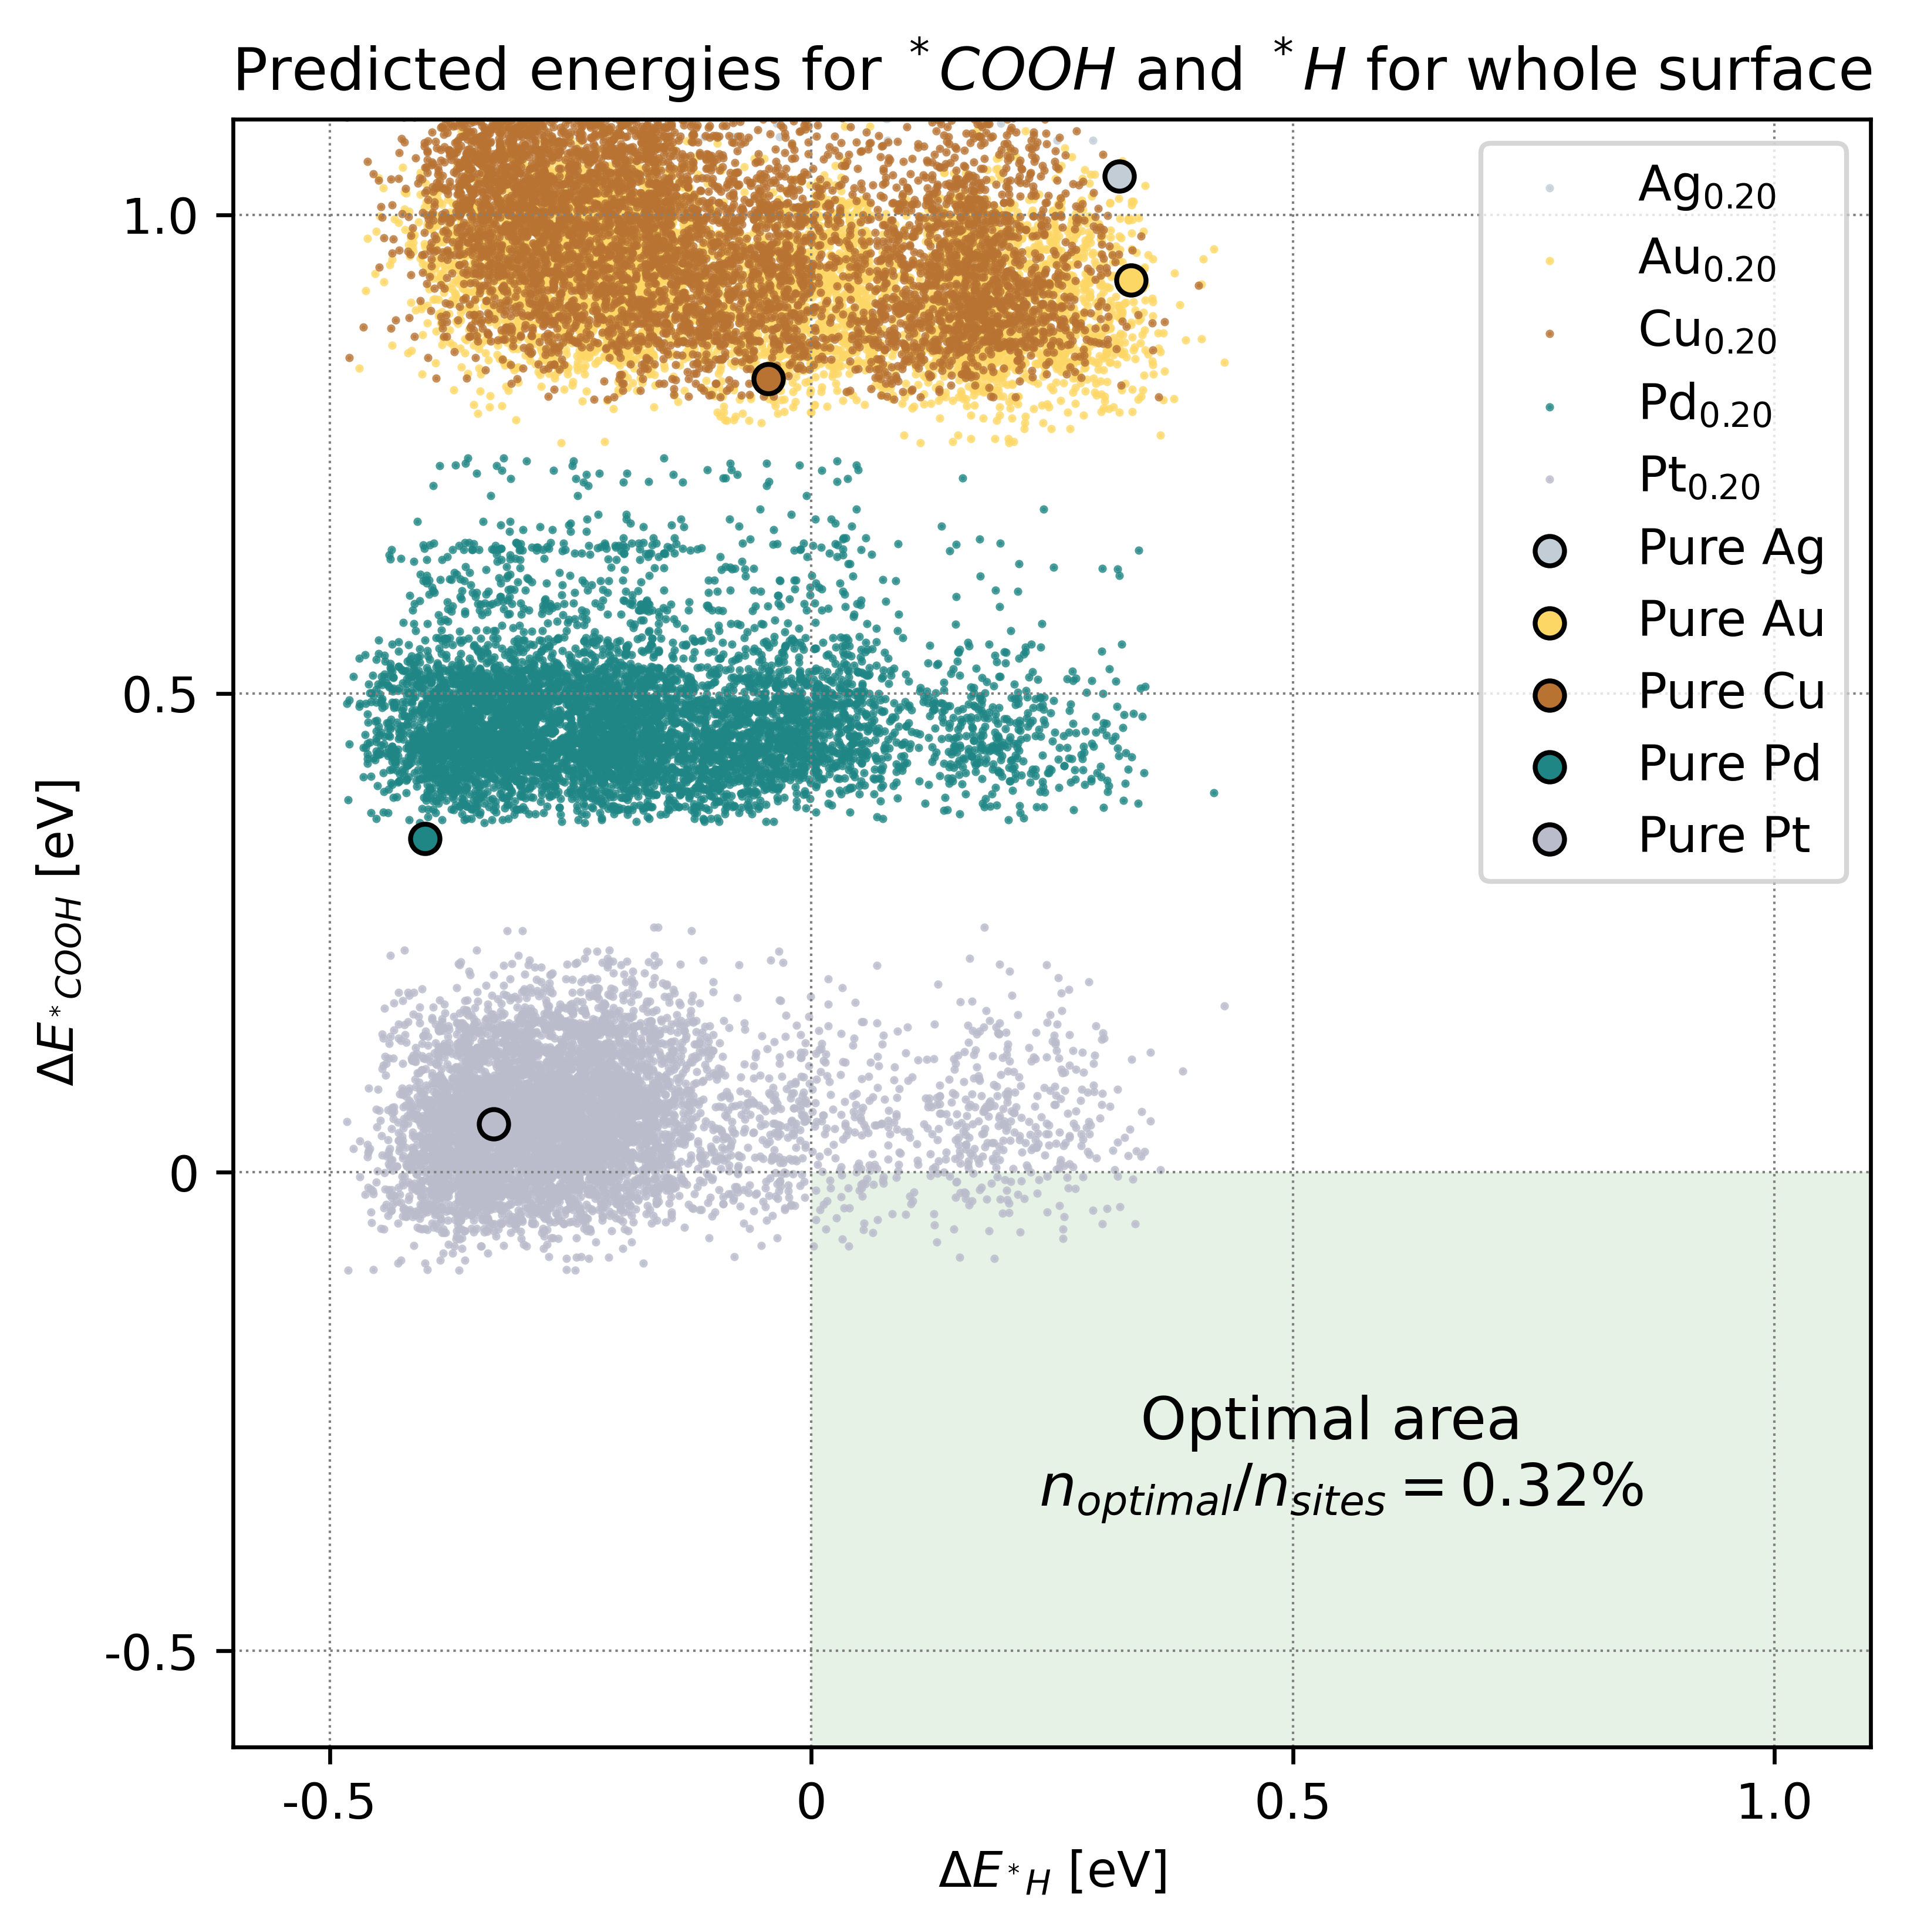
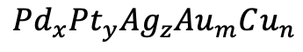
Stoichiometry:
$$Pd_{x}Pt_{y}Ag_{z}Au_{m}Cu_{n}$$

Slide 11
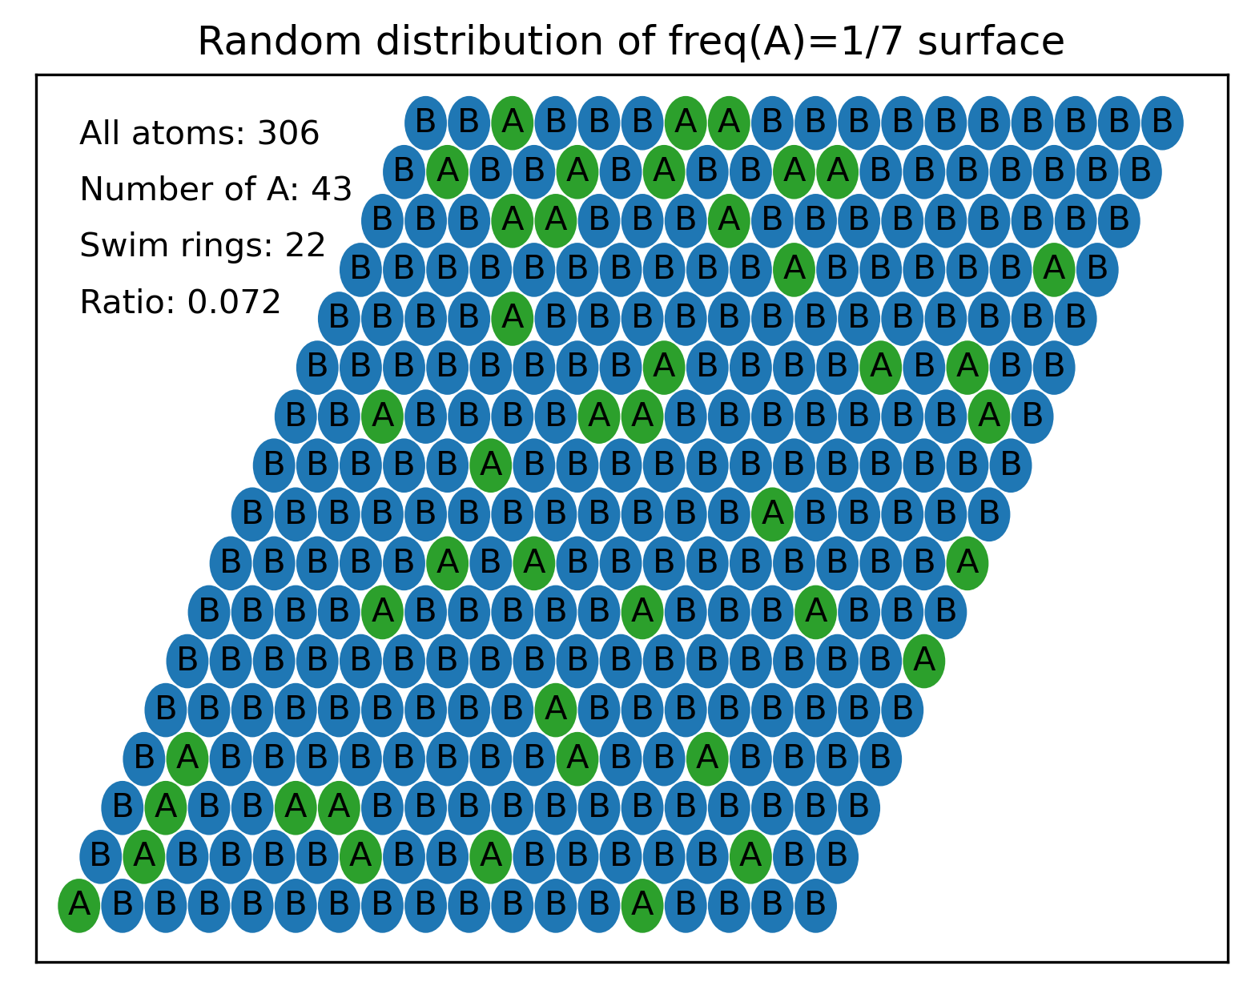
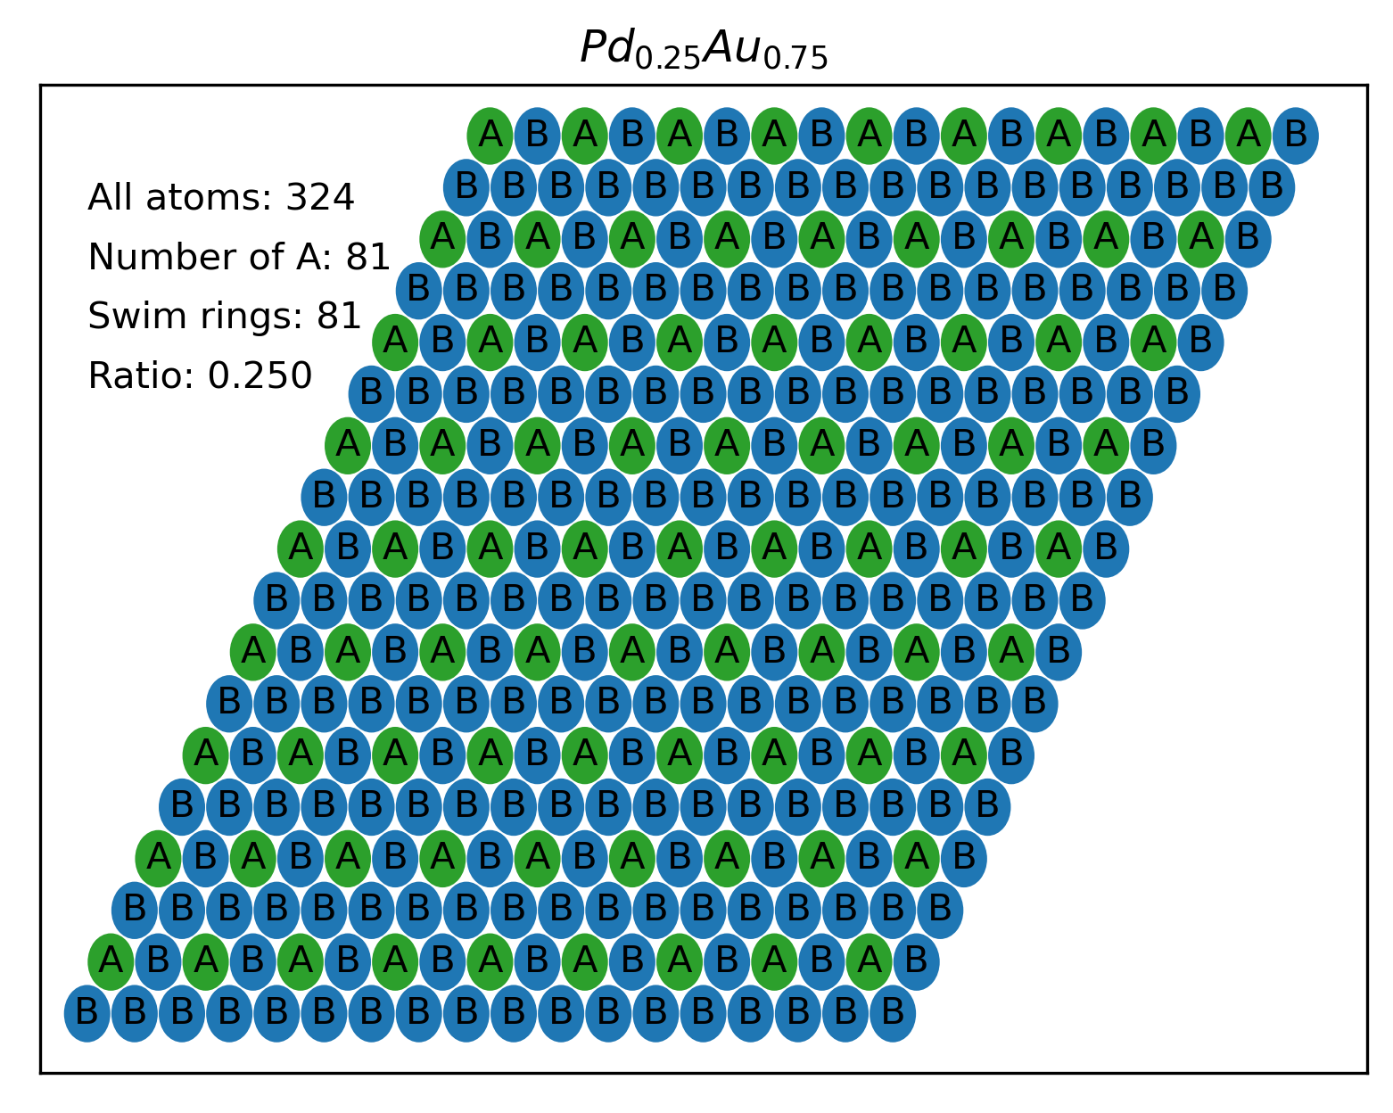
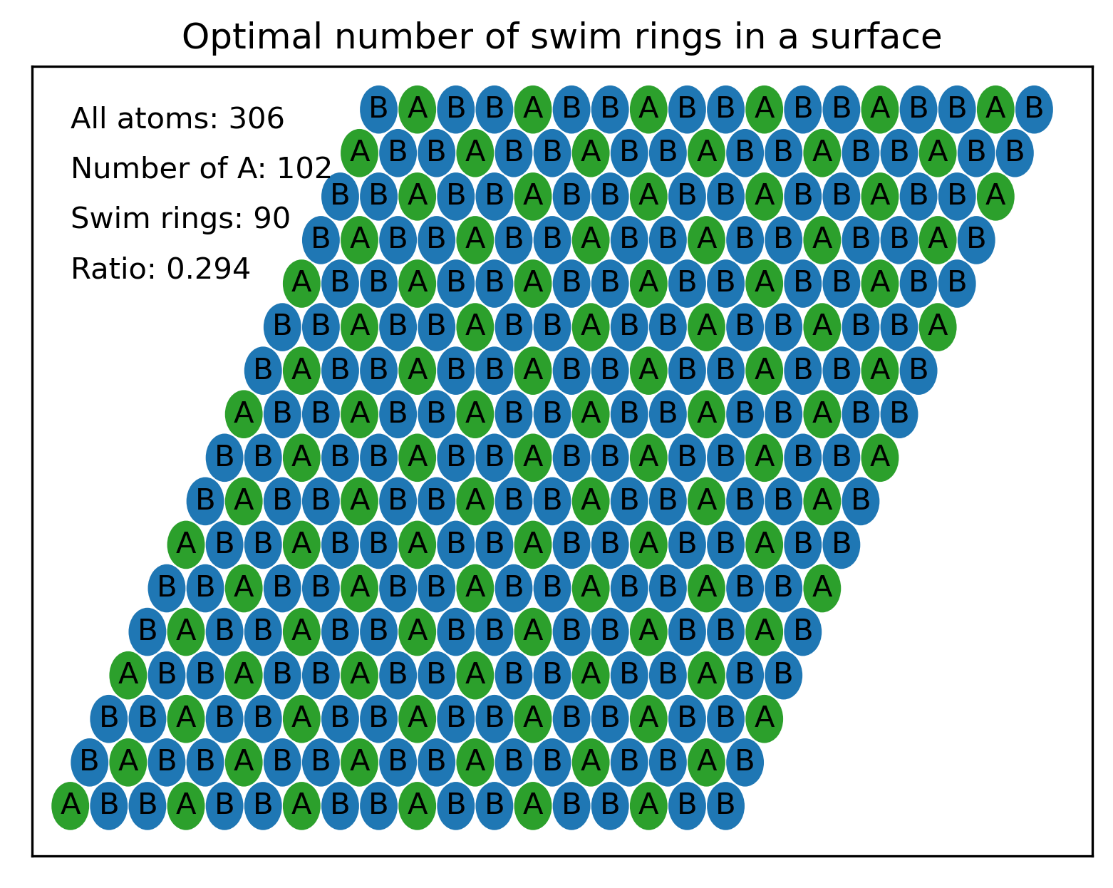
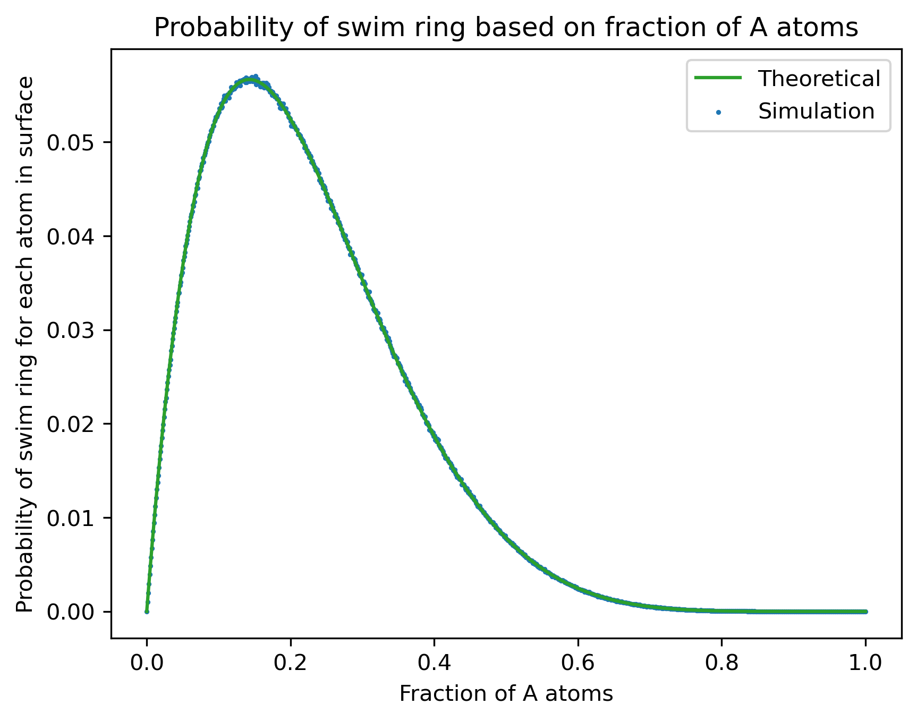
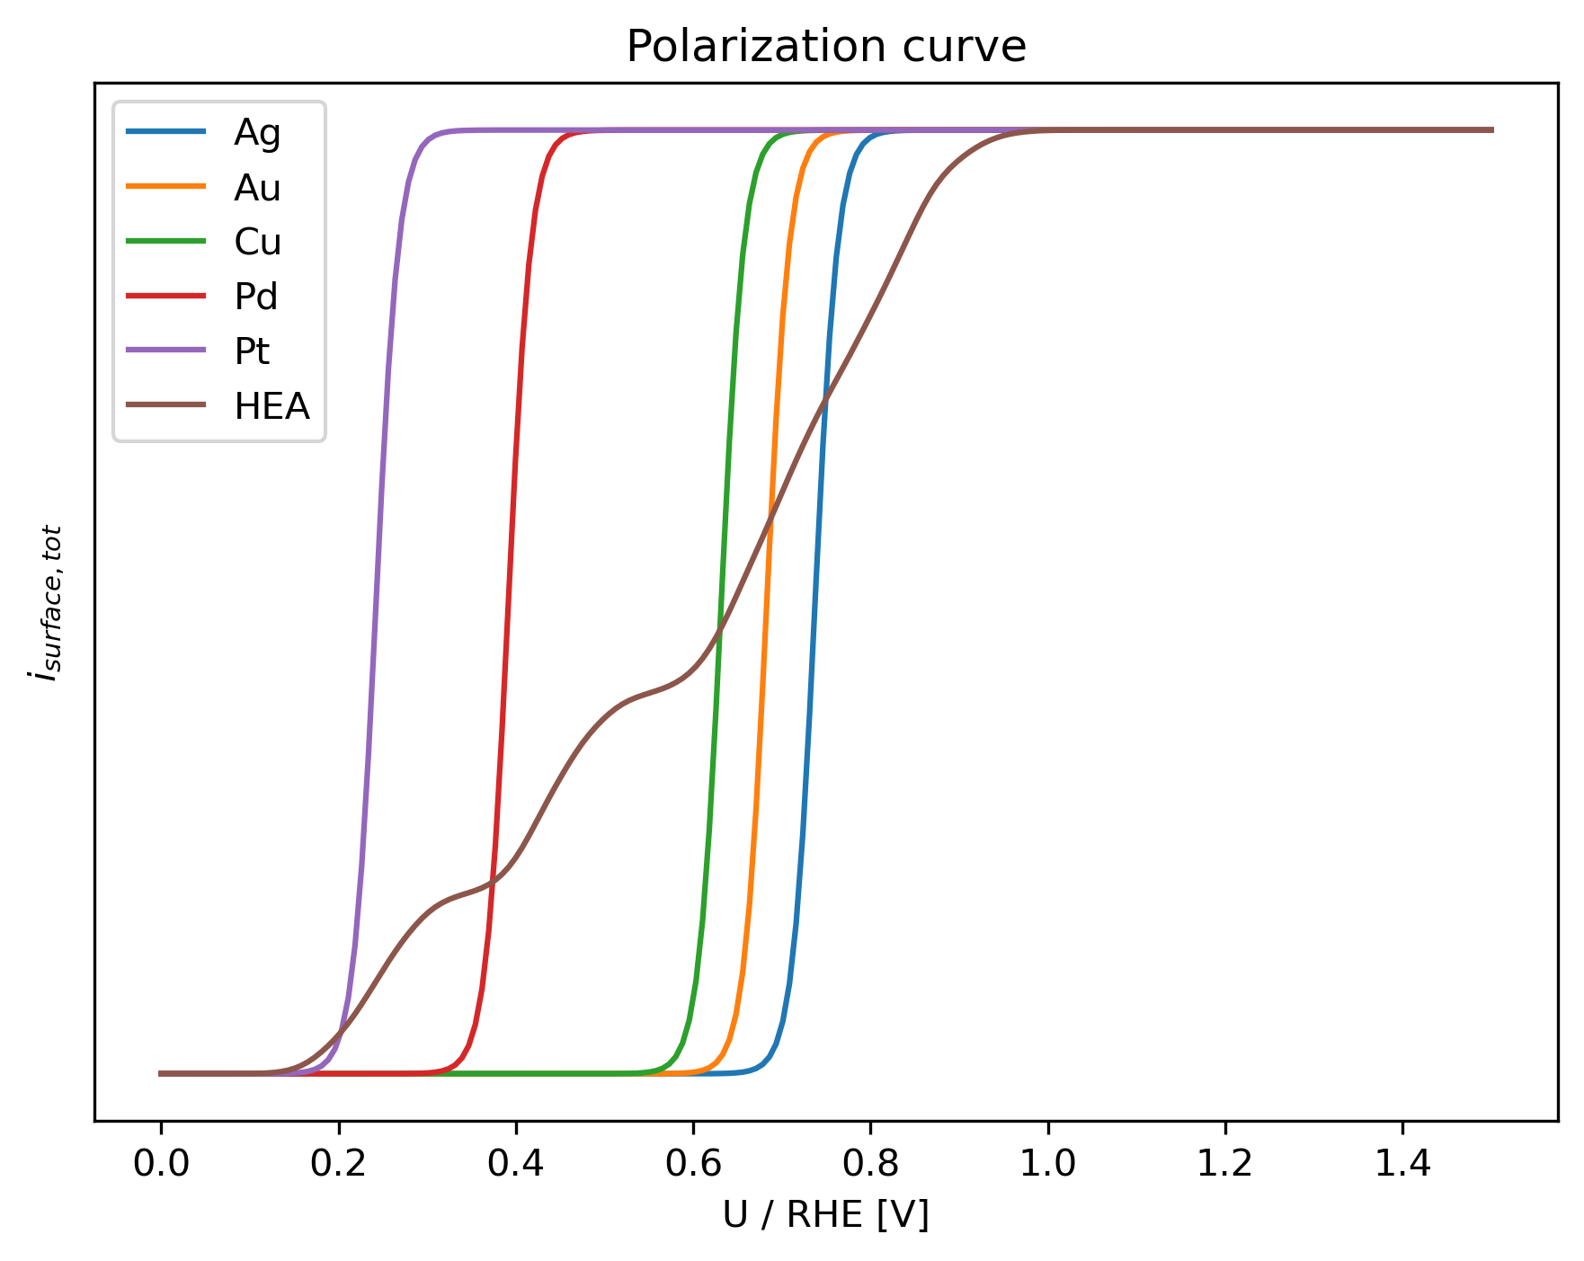
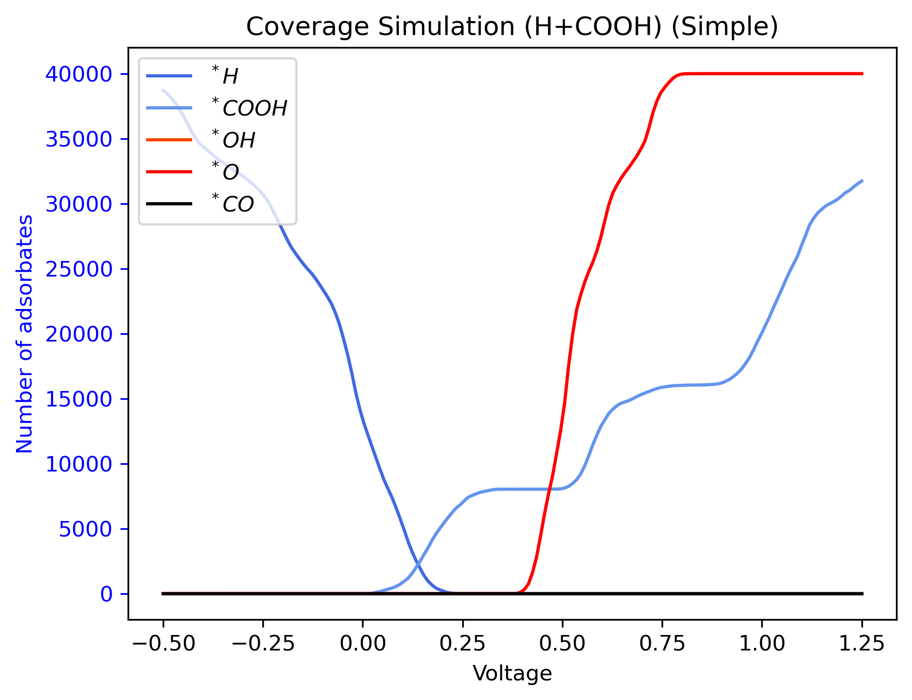
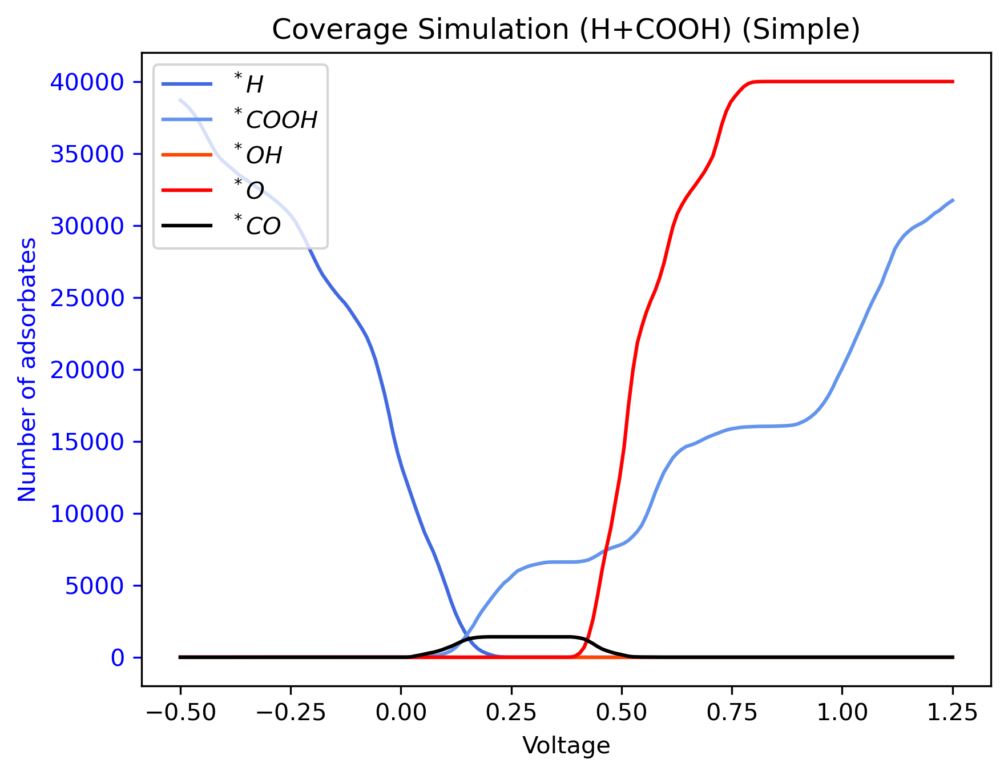
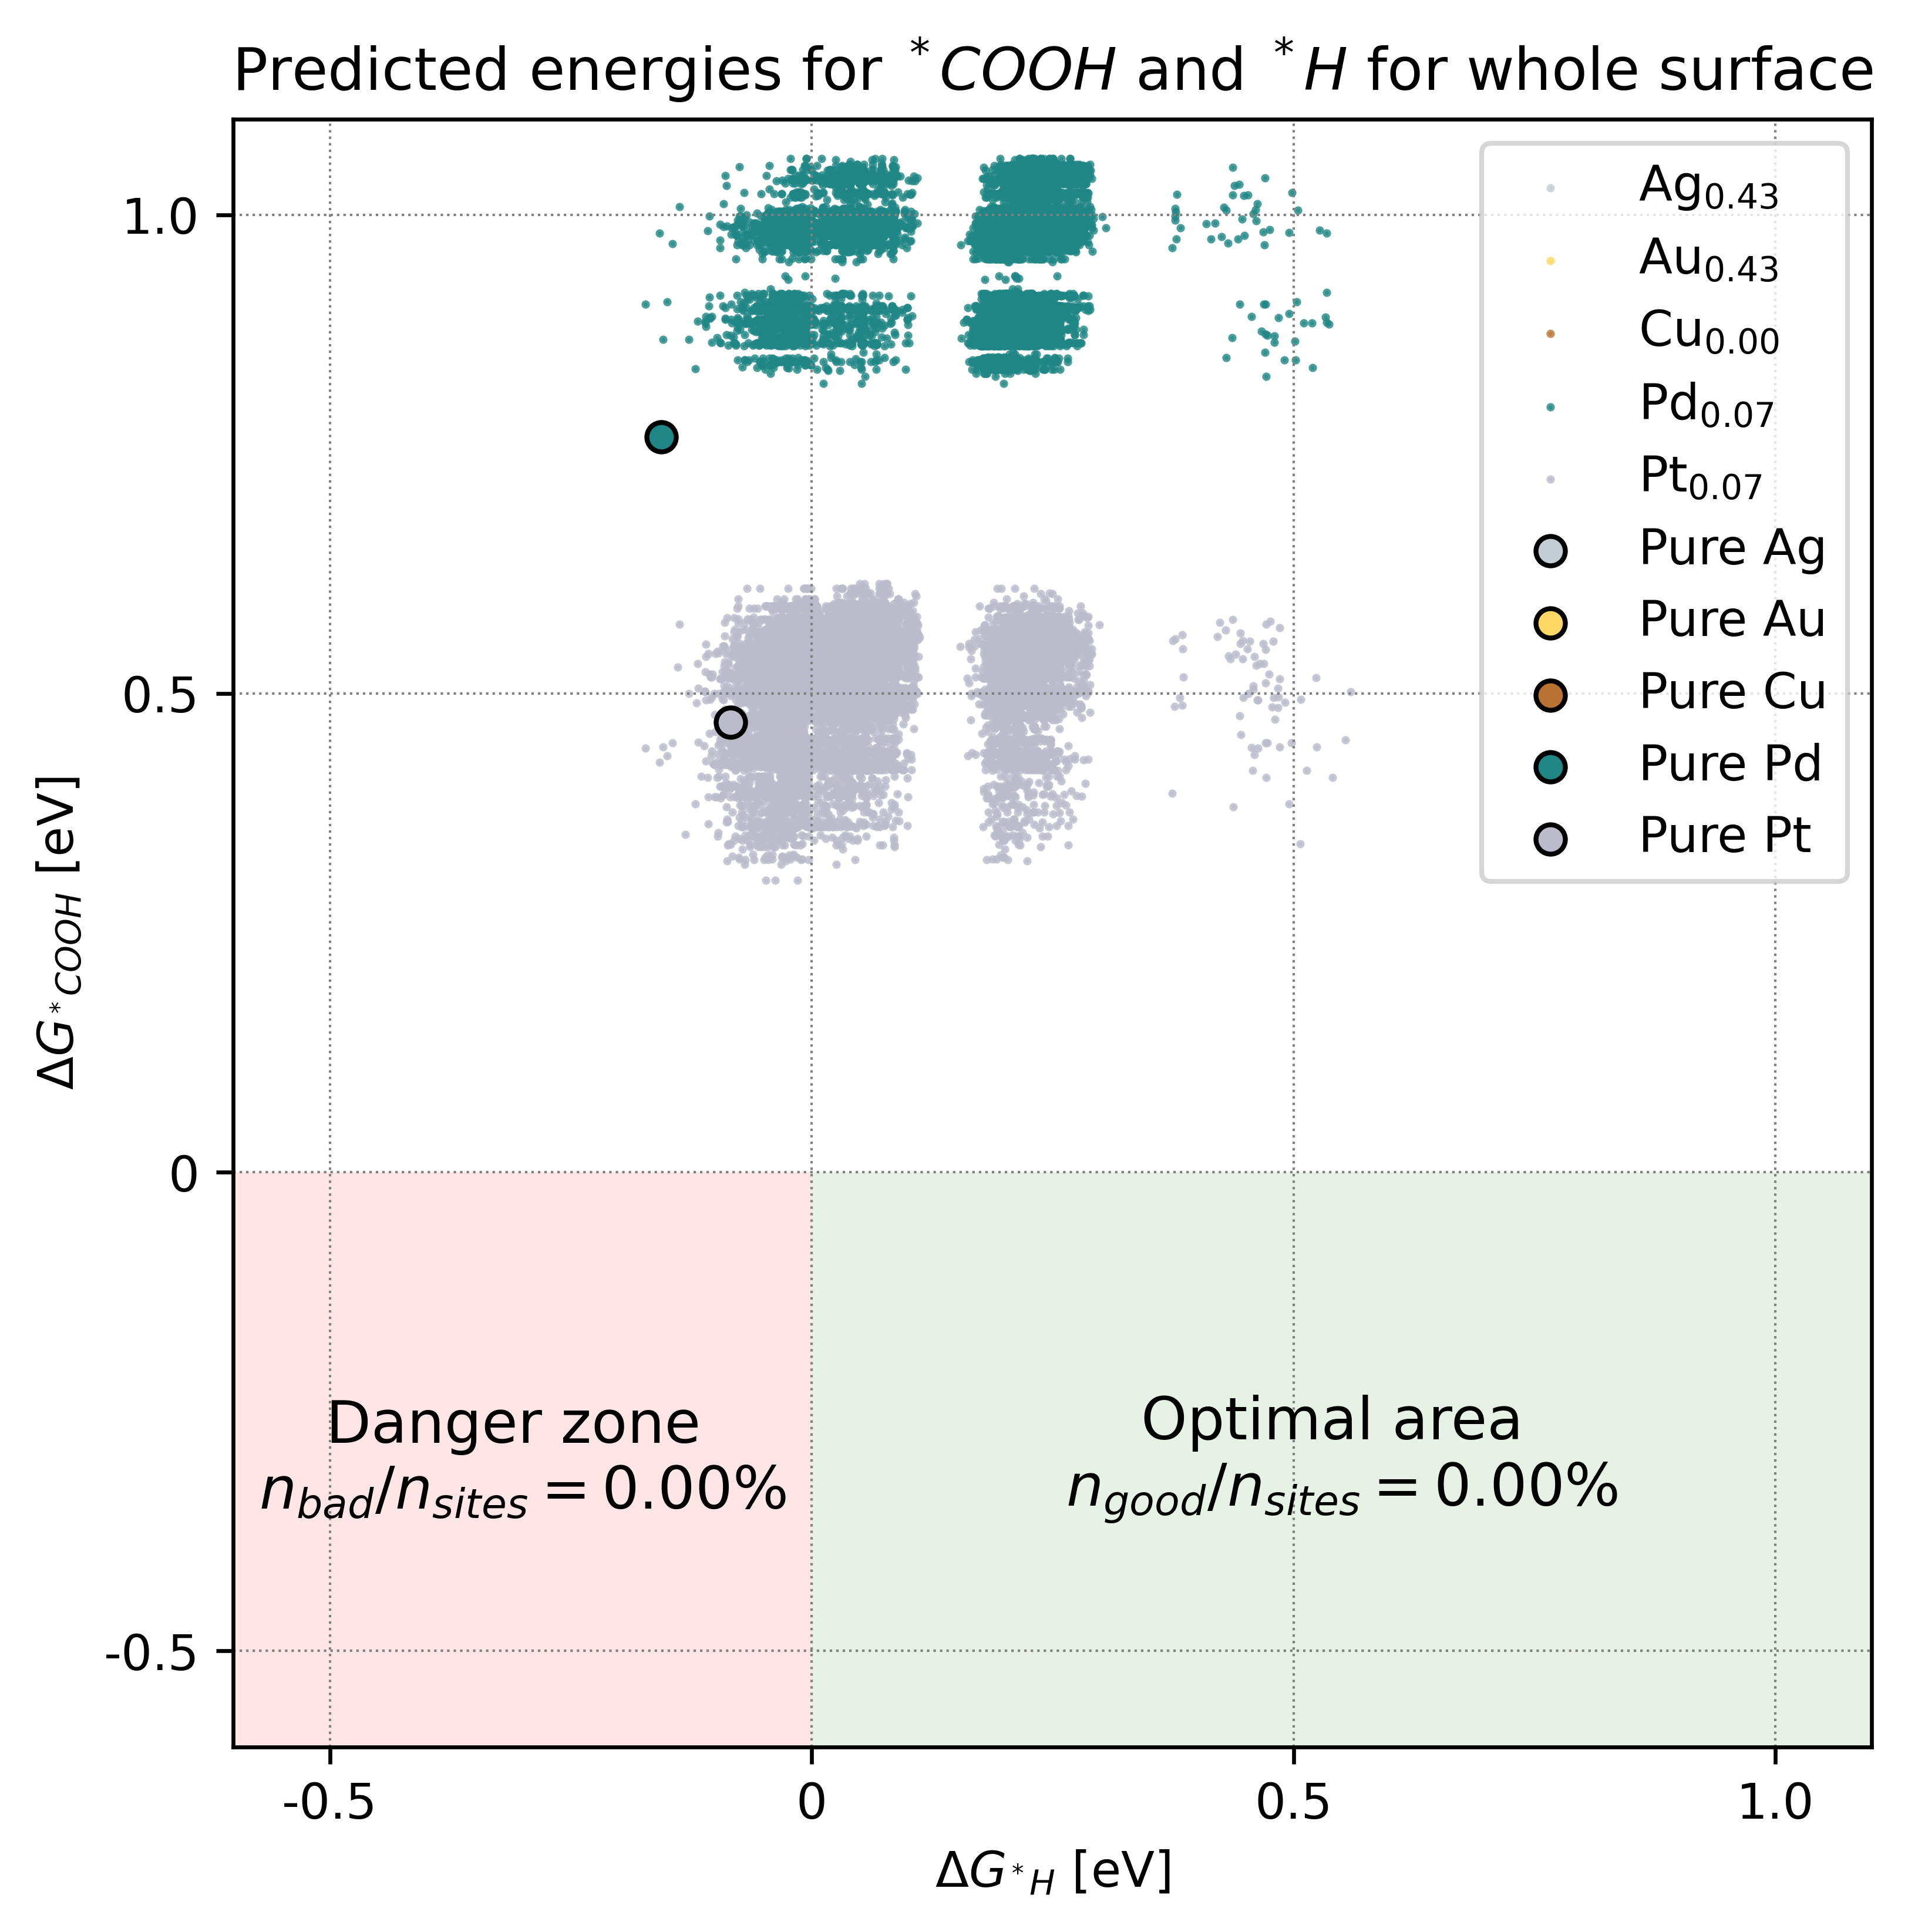
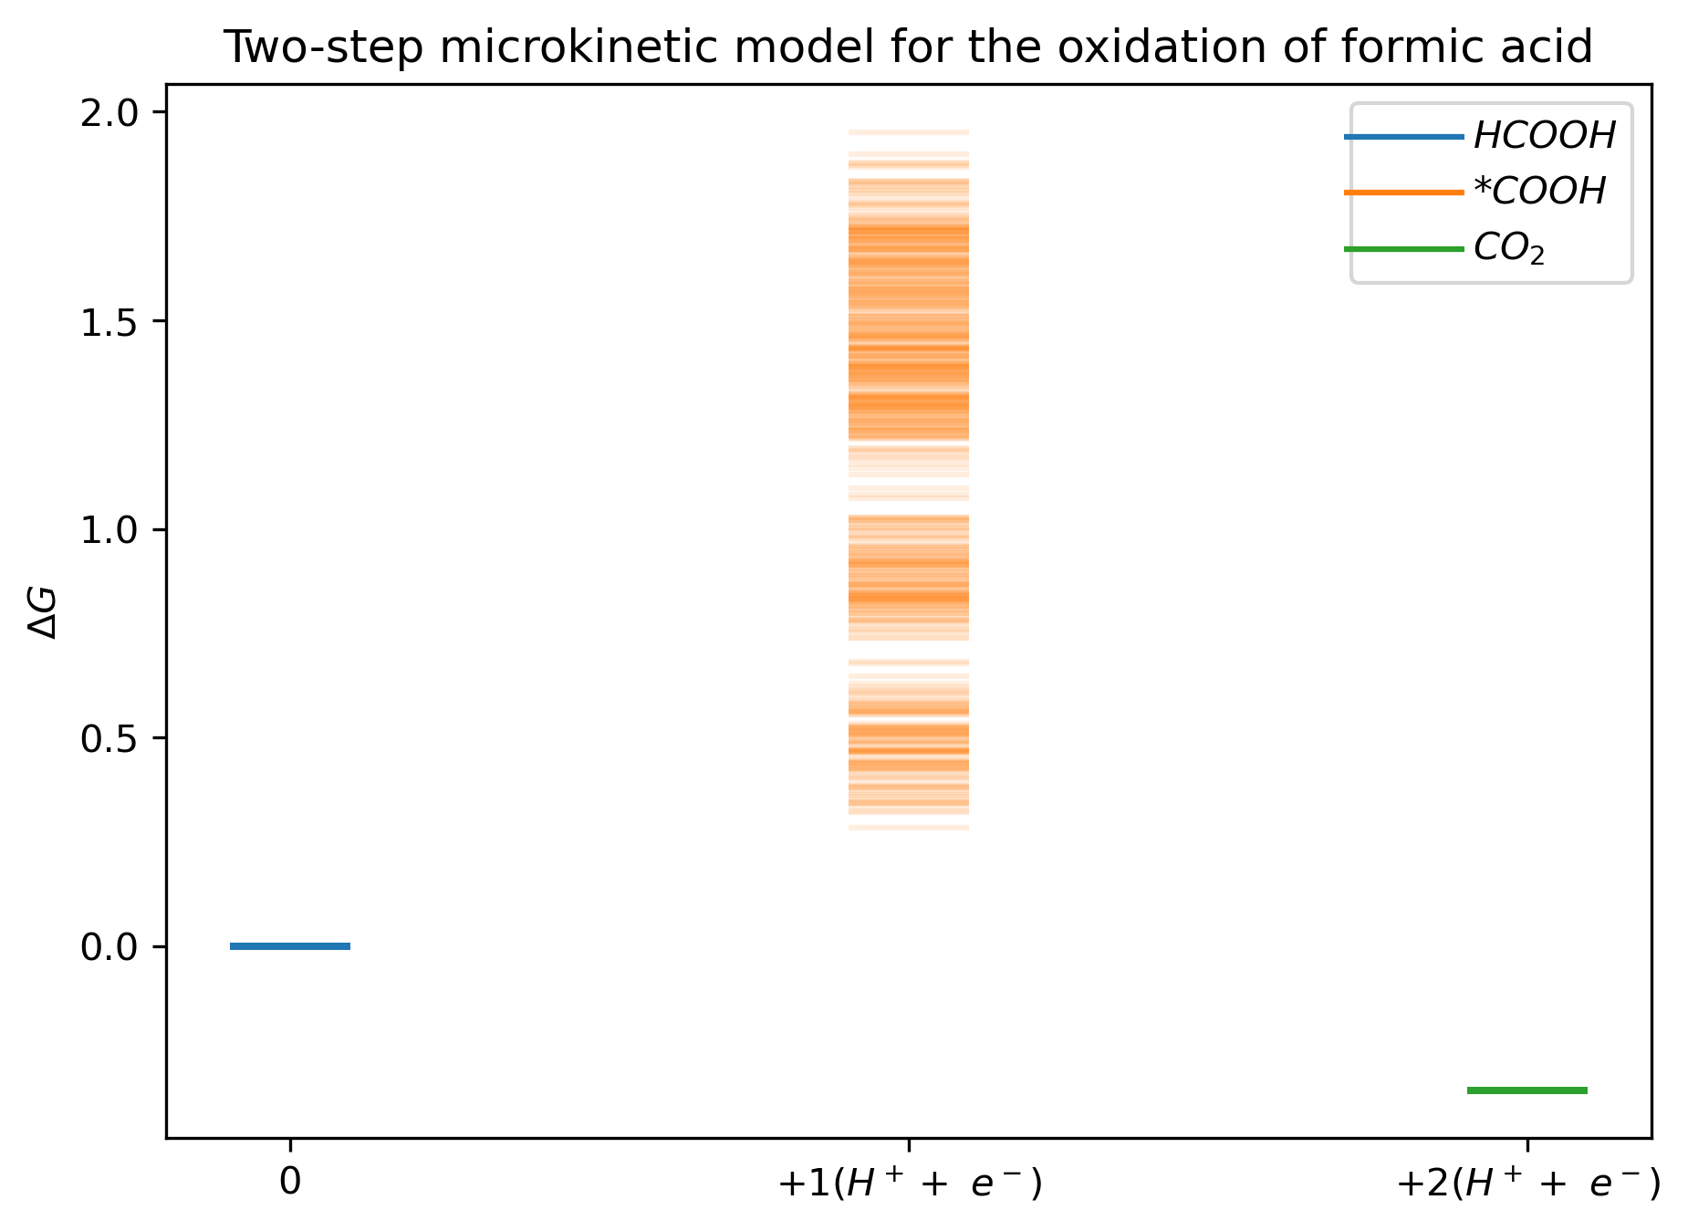
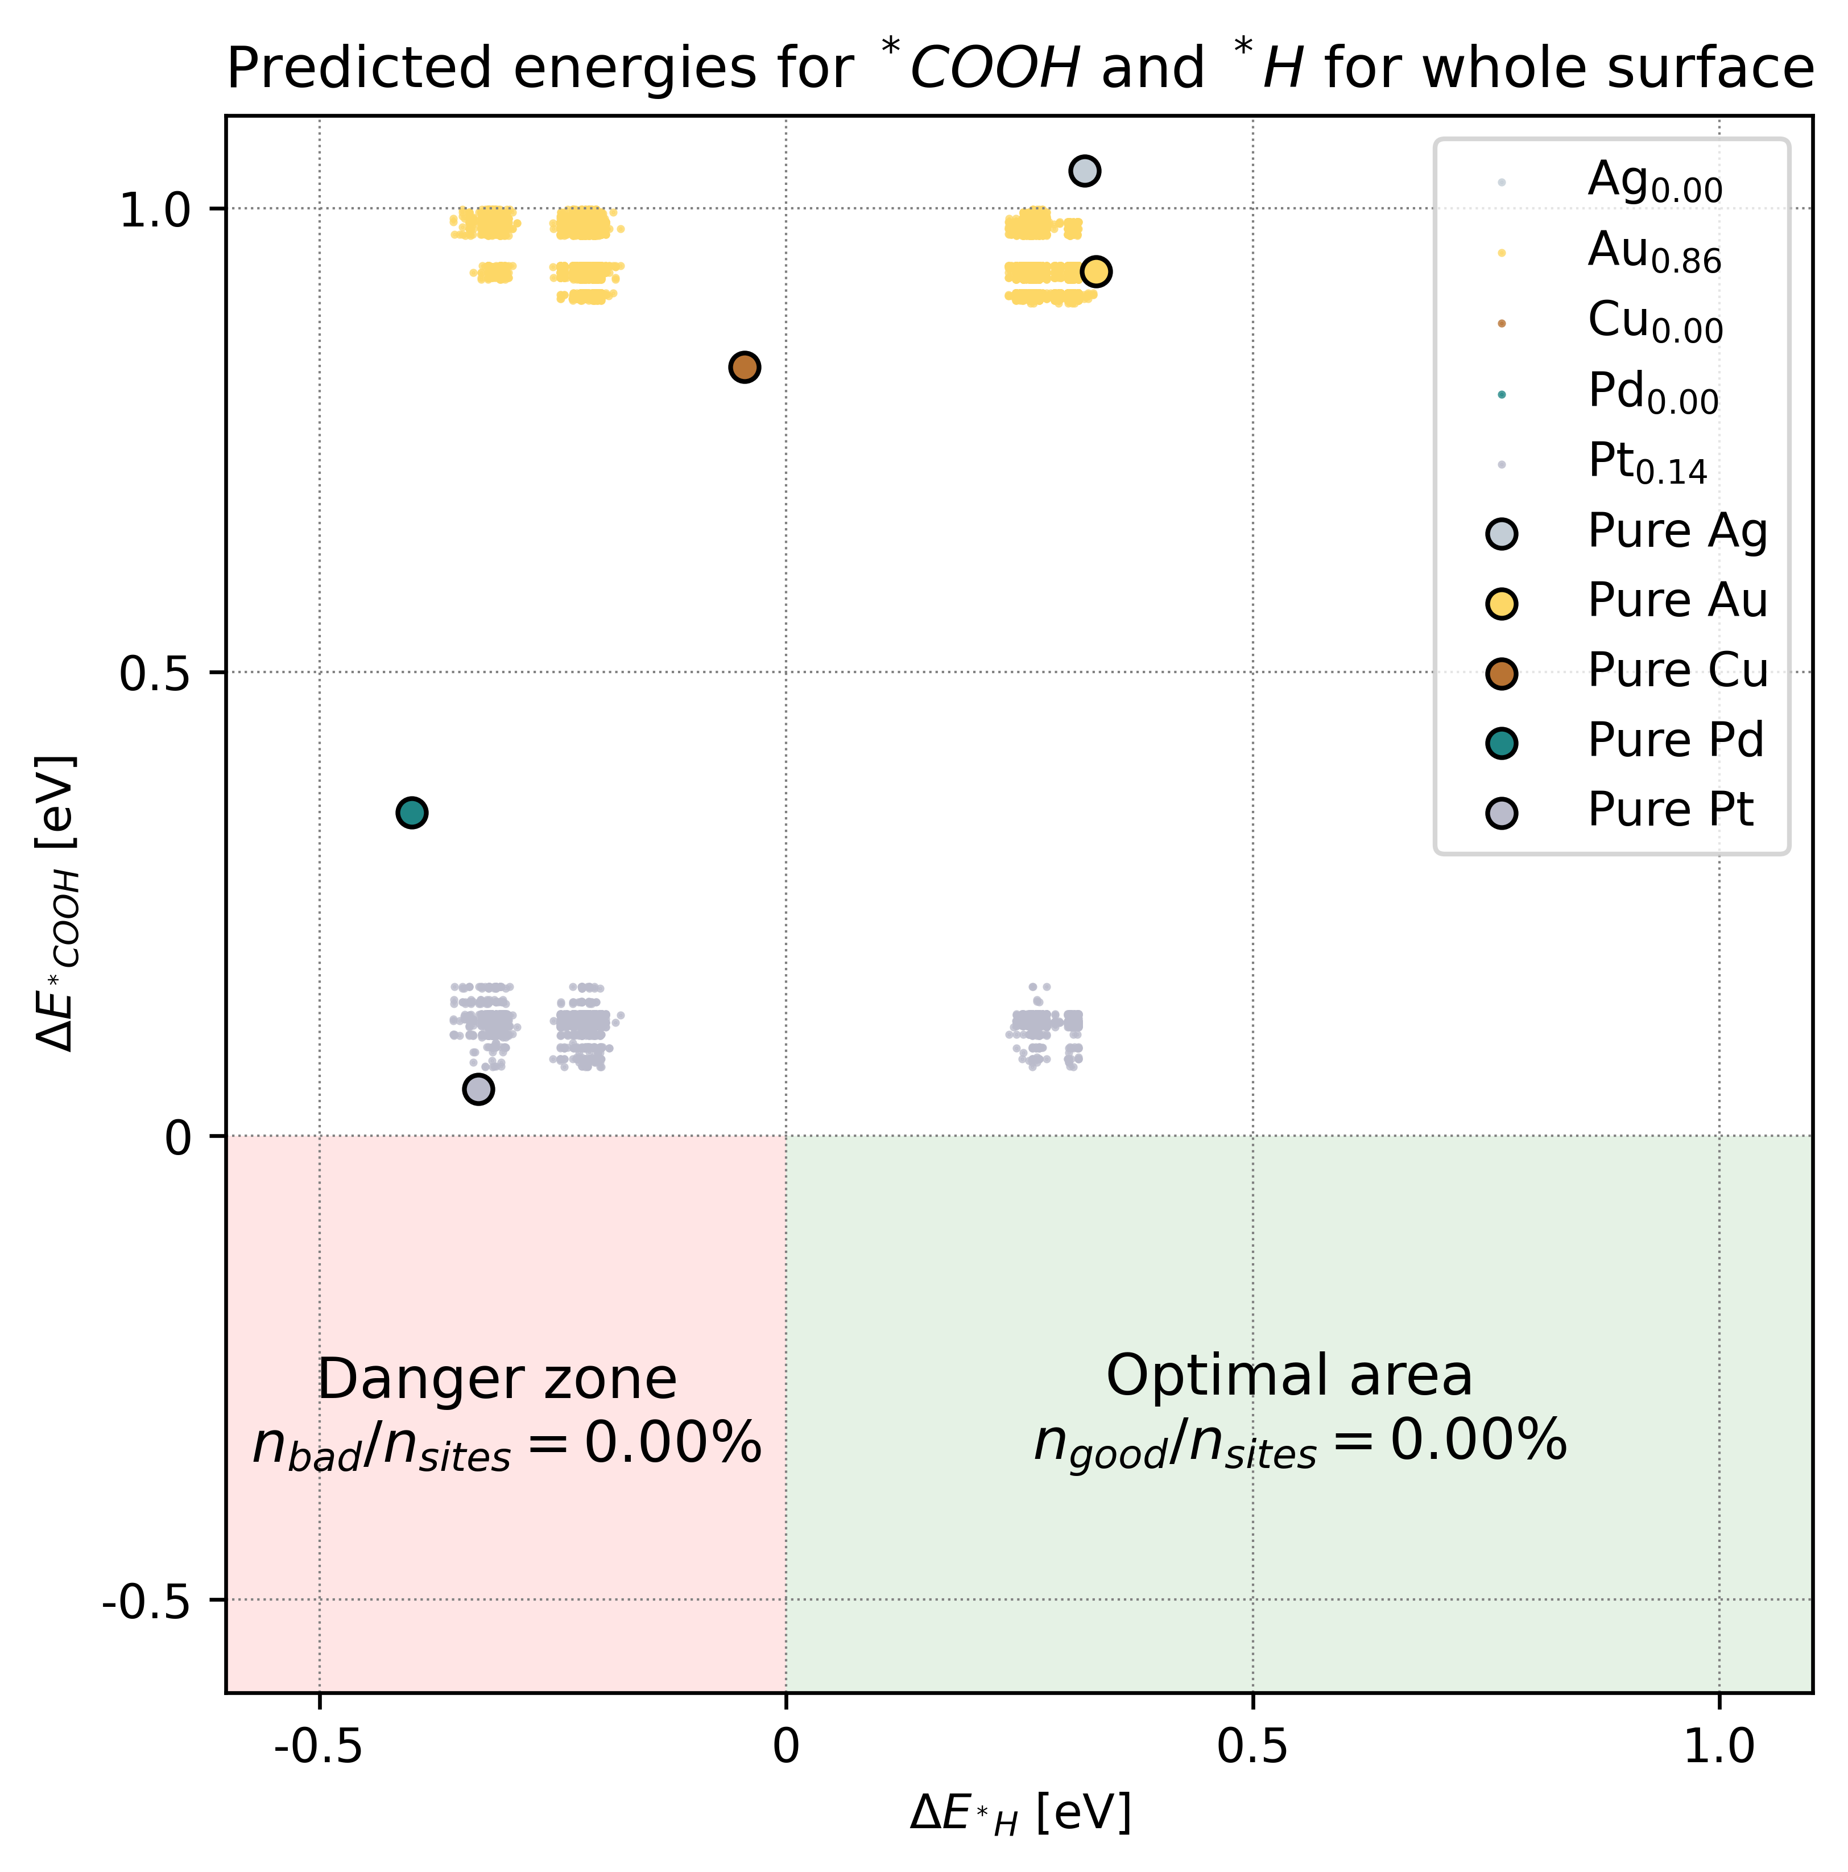

Slide 12
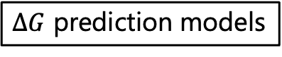
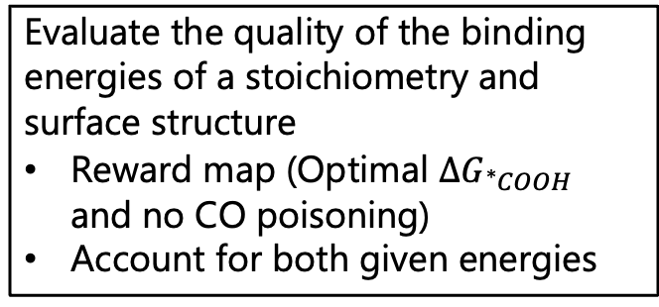
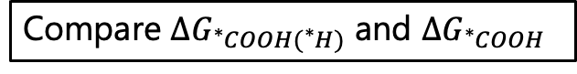
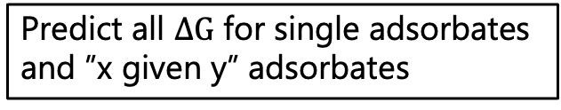
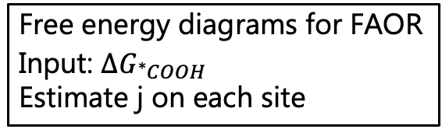
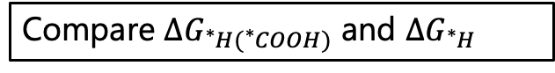
DFT data
Thermal corrections
Train ML models predicting binding energies
All single adsorbates
Mixed-site model for H +COOH
Parity plots
$ΔG$ prediction models
Binding energy of adsorbate H/COOH given that COOH/H is already adsorbed
Free energy diagrams for FAOR
Input: $ΔG_{{}_{ }^{∗}{COOH}}$
Estimate j on each site
Stoichiometry
Compare $ΔG_{{}_{ }^{∗}{COOH({}_{ }^{∗}H)}}$ and $ΔG_{{}_{ }^{∗}{COOH}}$
Simulate surface
HEA
Swim ring structure
Compare $ΔG_{{}_{ }^{∗}{H({}_{ }^{∗}{COOH})}}$ and $ΔG_{{}_{ }^{∗}H}$
Coverage simulation
Replicate disprop. reac.
Show adsorbates present while sweeping U
Predict all $ΔG$ for single adsorbates and ”x given y” adsorbates
Optimize stoichiometry for best FAOR performance
Evaluate the quality of the binding energies of a stoichiometry and surface structure
Reward map (Optimal $ΔG_{{}_{ }^{∗}{COOH}}$ and no CO poisoning)
Account for both given energies
Brute-force search:
5% molar fractions
Reward map as evaluation
Triangle plot
Bayesian Search:
Input: Binding energies (single and given)
Evaluation: Reward map
Output: New stoich guess

